Slide 1
A Few Points on Implementation

Slide 2
Implementation Approach
Formal side:
Action Plans
Gantt Charts
Informal Side
Change Techniques
Overcoming Resistance

Slide 3

Six Steps of Action Plans
Agreeing on Goals
Adopting Performance Measures
Determine the “who”, “what”, “when” of getting the work done.
Determining the level and type of resources to do the job
Determining the important interlocks between units and outside entities
Making financial estimate of plans’ impact.

Slide 4
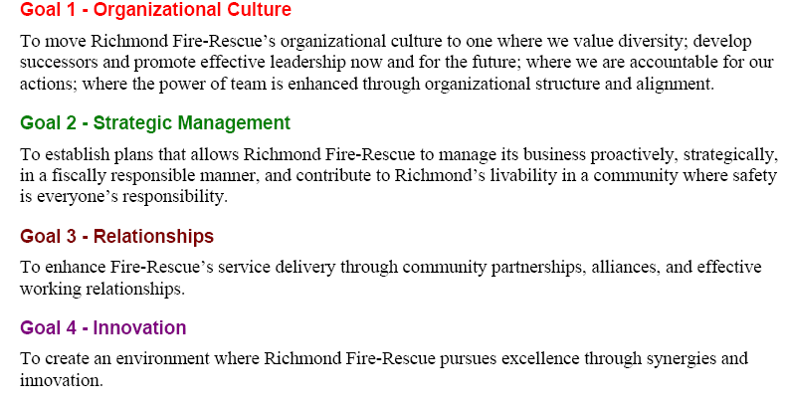
Example 1: Goals

Slide 5
Example 2: KPIs

Slide 6
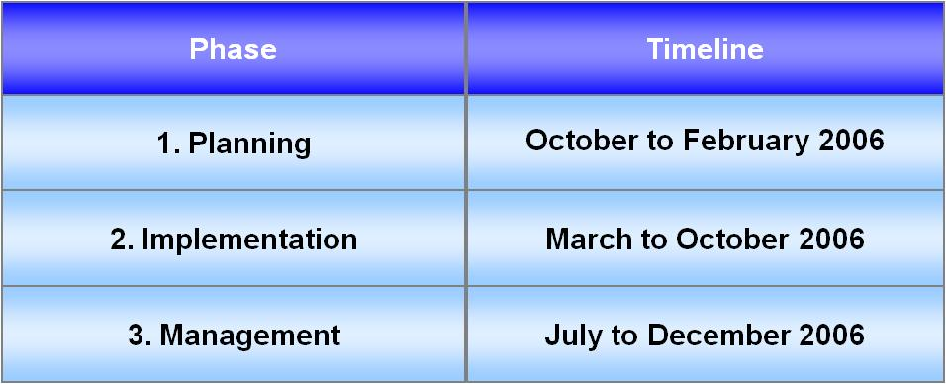
Example 1: Simple

Slide 7
First 4 months
Example 2: More Complex
Introduce & implement
Review & enhance

Slide 8
The Informal Side: Power & Mobilization
Attention
Learning
Buy-In
Deeper
Change
Temporary Plan
Momentum Increases
and
Power is Shared
Short-Term Outcomes
Communication Methods
Empowerment

Slide 9
Some Implementation Tactics
 | Diagnosis | Awareness | Interest | Trial
Personal profiles
Task forces
Coffee breaks
Social networks
Face-to-face meetings
Internal magazine
Electronic mail
Memorandum
Seek advice
Management training
Workshop
Staff meeting
Questionnaire
External speaker
Directors’ meeting
Pilot test
Directive
Covert lobbying

Slide 10
Summary The Standard Strategic Analysis Framework
Vision, Goals,
and Strategy
Strategic
Issue/Vision
Implement-
ation
Situation
Recommend-
ations
External
Analysis
Solution
Analysis
Internal
Analysis
Performance
Analysis

